Slide 1
Chapter 2 : Processes And Process Management

Slide 2
Introduction
Process Concept
Process Scheduling
Operations on Processes
Interprocess Communication
Examples of IPC Systems
Communication in Client-Server Systems

Slide 3
Objectives
To introduce the notion of a process -- a program in execution, which forms the basis of all computation
To describe the various features of processes, including scheduling, creation and termination, and communication
To describe communication in client-server systems

Slide 4
Process Concept
An operating system executes a variety of programs:
  Batch system – jobs
  Time-shared systems – user programs or tasks
Textbook uses the terms job and process almost interchangeably
Process – a program in execution; process execution must progress in sequential fashion
A process includes:
  program counter
  stack
  data section

Slide 5

Process in Memory

Slide 6
Process State
As a process executes, it changes state
  new: The process is being created
  running: Instructions are being executed
  waiting: The process is waiting for some event to occur
  ready: The process is waiting to be assigned to a processor
  terminated: The process has finished execution

Slide 7

Diagram of Process State

Slide 8
Implementation of Process- Processes Control Block (PCB)
Information associated with each process
Process state
Program counter
CPU registers
CPU scheduling information
Memory-management information
Accounting information
I/O status information

Slide 9

Process Control Block (PCB)

Slide 10

CPU Switch From Process to Process

Slide 11
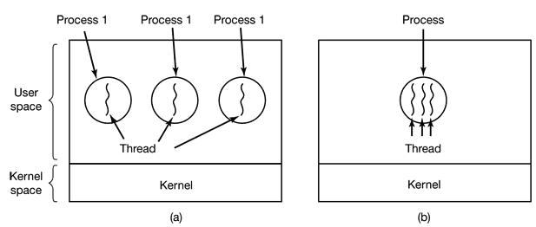
The Thread Model
Lightweight processes
Per process items | Per thread items
Address space | Program counter
Global variables | Registers
Open files | Stack
Child processes | State
Pending alarms
Signals and signal handlers
Accounting information

Slide 12
Why Threads?
Quasi Parallelism
They are easier to create and destroy than processes

Slide 13
Process Scheduling Queues
Job queue – set of all processes in the system
Ready queue – set of all processes residing in main memory, ready and waiting to execute
Device queues – set of processes waiting for an I/O device
Processes migrate among the various queues

Slide 14

Ready Queue And Various I/O Device Queues

Slide 15
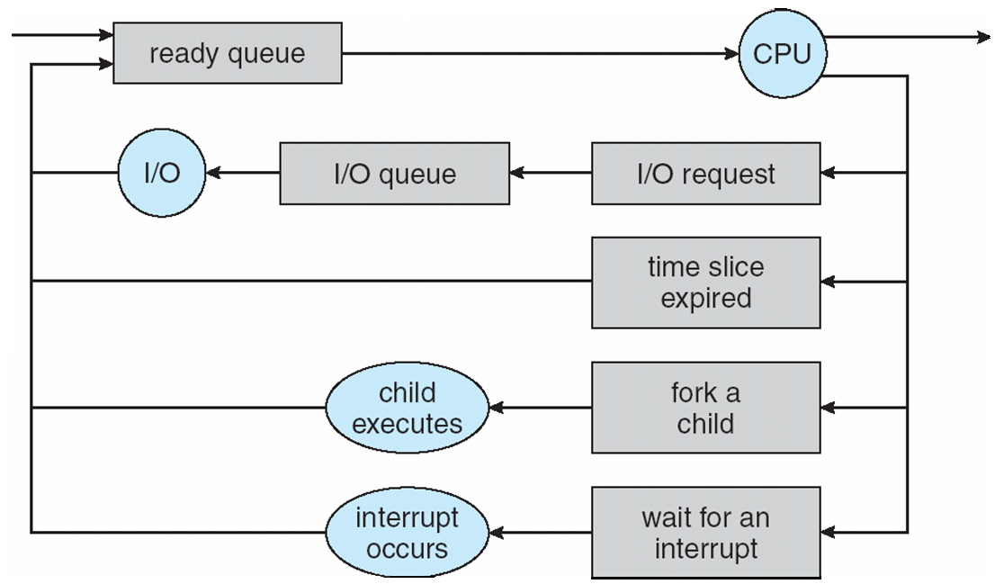
Representation of Process Scheduling

Slide 16
Schedulers
Selects which processes should be brought into the ready queue
Selects which process should be executed next and allocates CPU

Slide 17

Addition of Medium Term Scheduling

Slide 18
Schedulers (Cont)
Short-term scheduler is invoked very frequently (milliseconds) ⇒ (must be fast)
Long-term scheduler is invoked very infrequently (seconds, minutes) ⇒ (may be slow)
The long-term scheduler controls the degree of multiprogramming
Processes can be described as either:
  I/O-bound process – spends more time doing I/O than computations, many short CPU bursts
  CPU-bound process – spends more time doing computations; few very long CPU bursts

Slide 19
Context Switch
When CPU switches to another process, the system must save the state of the old process and load the saved state for the new process via a context switch
Context of a process represented in the PCB
Context-switch time is overhead; the system does no useful work while switching
Time dependent on hardware support

Slide 20
Process Creation
Process creation can be triggered in either of
  System initialization.
  Execution of a process creation system call by a running process.
  A user request to create a new process.
  Initiation of a batch job.
Parent process create children processes, which, in turn create other processes, forming a tree of processes
Generally, process identified and managed via a process identifier (pid)
Resource sharing
  Parent and children share all resources
  Children share subset of parent’s resources
  Parent and child share no resources
Execution
  Parent and children execute concurrently
  Parent waits until children terminate

Slide 21
Process Creation (Cont)
Address space
  Child duplicate of parent
  Child has a program loaded into it
UNIX examples
  fork system call creates new process
  exec system call used after a fork to replace the process’ memory space with a new program

Slide 22
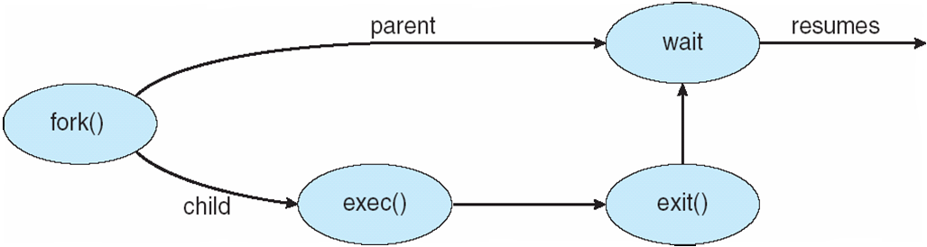
Process Creation

Slide 23
C Program Forking Separate Process
int main()
{
pid_t pid;
/* fork another process */
pid = fork();
if (pid < 0) { /* error occurred */
fprintf(stderr, "Fork Failed");
exit(-1);
}
else if (pid == 0) { /* child process */
execlp("/bin/ls", "ls", NULL);
}
else { /* parent process */
/* parent will wait for the child to complete */
wait (NULL);
printf ("Child Complete");
exit(0);
}
}

Slide 24
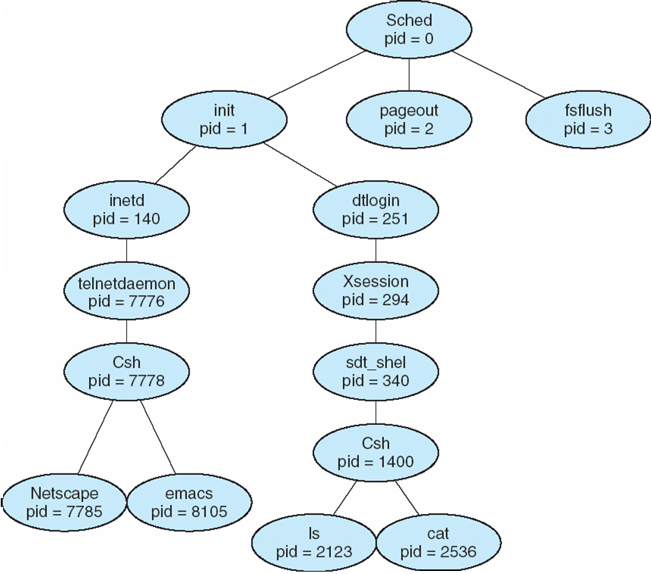
A tree of processes on a typical Solaris

Slide 25
Process Termination
Process Termination
  Normal exit (voluntary).
  Error exit (voluntary).
  Fatal error (involuntary).
  Killed by another process (involuntary)
Process executes last statement and asks the operating system to delete it (exit)
  Output data from child to parent (via wait)
  Process’ resources are de-allocated by operating system
Parent may terminate execution of children processes (abort)
  Child has exceeded allocated resources
  Task assigned to child is no longer required
  If parent is exiting
    Some operating system do not allow child to continue if its parent terminates
      All children terminated - cascading termination

Slide 26
Interprocess Communication
Processes within a system may be independent or cooperating
Cooperating process can affect or be affected by other processes, including sharing data
Reasons for cooperating processes:
  Information sharing
  Computation speedup
  Modularity
  Convenience
Cooperating processes need interprocess communication (IPC)
Two models of IPC
  Shared memory
  Message passing

Slide 27

Communications Models

Slide 28
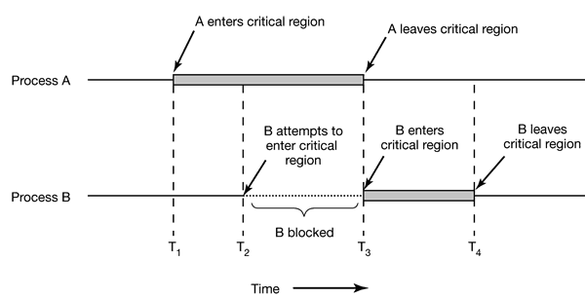
Communications Model…
Race Conditions , Critical sections, & Mutual Exclusion

Slide 29
Communication Models…
  Although mutual exclusion avoids race conditions, it is not sufficient for having parallel processes cooperate correctly and efficiently using shared data.
  There needs to be four conditions to hold to have a good solution:
    No two processes may be simultaneously inside their critical regions
    No assumptions may be made about speeds or the number of CPUs
    No process running outside its critical region may block other processes
    No process should have to wait forever to enter its critical region

Slide 30
Communication Models…
  Techniques for achieving mutual exclusion
    Mutual Exclusion with Busy Waiting
      Disabling Interrupts
      Lock Variables
      Strict Alternation
      Peterson’s Algorithm
      The TSL Instruction

Slide 31
Communication Models…
  Assignment- Group 1
  - Prepare a comparative analysis of the busy-waiting algorithms described in the previous slide.

Slide 32
Communication Models…
Mutual Exclusion without Busy Waiting
  Problems of Busy-Waiting
    Wastes CPU time
    Priority inversion problem
  Blocking instead of wasting CPU time- Without Busy Waiting

Slide 33
Cooperating Processes
Independent process cannot affect or be affected by the execution of another process
Cooperating process can affect or be affected by the execution of another process
Advantages of process cooperation
  Information sharing
  Computation speed-up
  Modularity
  Convenience

Slide 34
Producer-Consumer Problem
Paradigm for cooperating processes, producer process produces information that is consumed by a consumer process
  unbounded-buffer places no practical limit on the size of the buffer
  bounded-buffer assumes that there is a fixed buffer size

Slide 35
Bounded-Buffer – Producer
while (true) {
/* Produce an item */
while (((in = (in + 1) % BUFFER SIZE count) == out)
; /* do nothing -- no free buffers */
buffer[in] = item;
in = (in + 1) % BUFFER SIZE;
}

Slide 36
Bounded Buffer – Consumer
while (true) {
while (in == out)
; // do nothing -- nothing to consume
// remove an item from the buffer
item = buffer[out];
out = (out + 1) % BUFFER SIZE;
return item;
}

Slide 37
Producer-Consumer Problem…
Sleep and Wakeup – uses two system calls called sleep and wakeup. Sleep causes the caller to block, that is, be suspended until another process wakes it up. The wakeup call awakens a process blocked by sleep.

Slide 38
Producer-Consumer Problem…
#define N 100 /* number of slots in the buffer */ int count = 0; /* number of items in the buffer */ void producer (void) { int item; while (TRUE) { /* repeat forever */ item = produce_item(); /* generate next item */ if (count == N) sleep(); /* if buffer is full, go to sleep */ insert_item(item); /* put item in buffer */ count = count + 1; /* increment count of items in buffer */ if (count == 1) wakeup(consumer); /* was buffer empty? */ } } | void consumer(void) { int item; while (TRUE) { /* repeat forever */ if (count == 0) sleep(); /* if buffer is empty, got to sleep */ item = remove_item(); /* take item out of buffer */ count = count − 1; /* decrement count of items in buffer */ if (count == N − 1) wakeup(producer); /* was buffer full? */ consume_item(item); /* print item */ } }

Slide 39
Semaphores
Uses an integer variable (semaphore) to count the number of wakeups saved for future use.
A semaphore could have the value 0, indicating that no wakeups were saved, or some positive value if one or more wakeups were pending.
Two operations, down and up (generalizations of sleep and wakeup, respectively) would be performed on this variable.
The down operation on a semaphore checks to see if the value is greater than 0.
  If so, it decrements the value (i.e., uses up one stored wakeup) and just continues.
  If the value is 0, the process is put to sleep without completing the down for the moment. Checking the value, changing it and possibly going to sleep, is all done as a single, indivisible atomic action.

Slide 40
Semaphores…
This atomicity is absolutely essential to solving synchronization problems and avoiding race conditions.
The up operation increments the value of the semaphore addressed.
  If one or more processes were sleeping on that semaphore, unable to complete an earlier down operation, one of them is chosen by the system (e.g., at random) and is allowed to complete its down.

Slide 41
Other Possible IPC Mechanisms
Classical IPC Problems
  The Dining Philosophers Problem
  The Readers and Writers Problem
  The Sleeping Barber Problem
Assignment Group II-
  Semaphore
  Monitors
  Message Passing

Slide 42
Interprocess Communication – Message Passing
Mechanism for processes to communicate and to synchronize their actions
Message system – processes communicate with each other without resorting to shared variables
IPC facility provides two operations:
  send(message) – message size fixed or variable
  receive(message)
If P and Q wish to communicate, they need to:
  establish a communication link between them
  exchange messages via send/receive
Implementation of communication link

Slide 43
Communications in Client-Server Systems
Sockets
Remote Procedure Calls
Remote Method Invocation (Java)

Slide 44
SCHEDULING
Why Scheduling?
  Multiprogramming
The part of the operating system that makes the choice is called the scheduler and the algorithm it uses is called the scheduling algorithm.
Process Behavior:
  Compute-Bound
  I/O-Bound
When to Schedule?
  When a new process is created
  When a process exits.
  When a process blocks on I/O, on a semaphore, or for some other reason
  When an I/O interrupt occurs

Slide 45
SCHEDULING…
Scheduling algorithms can be divided into two categories:
  Non-preemptive- run through completion
    Suited for batch systems
  Preemptive- the scheduler picks a process and lets it run for a maximum of some fixed time.
    Suited for interactive systems

Slide 46
SCHEDULING…
Scheduling Algorithm Goals
  All systems
    Fairness - giving each process a fair share of the CPU
    Policy enforcement - seeing that stated policy is carried out
    Balance - keeping all parts of the system busy
  Batch systems
    Throughput - maximize jobs per hour
    Turnaround time - minimize time between submission and termination
    CPU utilization - keep the CPU busy all the time
  Interactive systems
    Response time - respond to requests quickly
    Proportionality - meet users’ expectations
  Real-time systems
    Meeting deadlines - avoid losing data
    Predictability - avoid quality degradation in multimedia systems

Slide 47

Scheduling in Batch Systems
First-Come First-Served –
  It is a nonpreemptive algorithm, processes are assigned the CPU in the order they request it.
  Basically, there is a single queue of ready processes.
  When the first job enters the system, it is started immediately and allowed to run as long as it wants to.
  Strength
    Easy to understand and equally easy to program
  Limitations
    Performs better for long processes and it favors I/O bound processes.

Slide 48
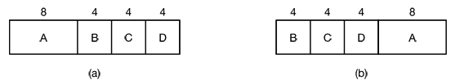

Scheduling in Batch Systems…
Shortest Job First –
  is a nonpreemptive batch algorithm , that assumes the run times are known in advance, and picks the shortest job first.
  When all the jobs are available simultaneously, shortest job first is optimal.
  Consider the following four jobs A,B,C, and D with the indicated run times.
Turnaround time using SJF (b)
B 4 minutes
C 8 minutes
D 12 minutes
A 20 minutes
Average 11 minutes

Slide 49
Scheduling in Batch Systems…
Shortest Remaining Time Next
  is a preemptive version of shortest job first. With this algorithm, the scheduler always chooses the process whose remaining run time is the shortest. Again here, the run time has to be known in advance.
  When a new job arrives, its total time is compared to the current process’ remaining time.
  If the new job needs less time to finish than the current process, the current process is suspended and the new job started. This scheme allows new short jobs to get good service.

Slide 50
Scheduling in Interactive Systems
Round-Robin Scheduling
  each process is assigned a time interval, called its quantum,
  If the process is still running at the end of the quantum, the CPU is preempted and given to another process.
  If the process has blocked or finished before the quantum has elapsed, the CPU is switched to another process.
  the length of the quantum should be set carefully:
    setting the quantum too short causes too many process switches and lowers the CPU efficiency, and
    setting it too long may cause poor response to short interactive requests.
    A quantum around 20-50 milliseconds is often a reasonable compromise.

Slide 51
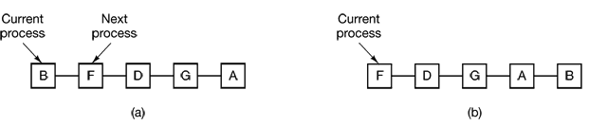
Scheduling in Interactive Systems…
Strength of Round-Robin algorithm
  Simple to implement
  Fair

Slide 52
Scheduling in Interactive Systems…
Priority Scheduling
  each process is assigned a priority, and the runnable process with the highest priority is allowed to run.
  To prevent high-priority processes from running indefinitely, the scheduler may decrease the priority of the currently running process at each clock tick (i.e., at each clock interrupt).
  If this action causes its priority to drop below that of the next highest process, a process switch occurs.
  It is often convenient to group processes into priority classes and use priority scheduling among the classes but round-robin scheduling within each class.

Slide 53
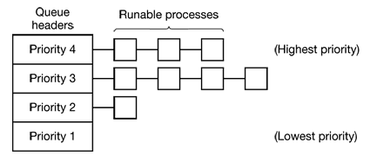
Scheduling in Interactive Systems…
Priority Scheduling

Slide 54
Scheduling in Interactive Systems…
Shortest Process Next:
  the shortest process will be run first
  Challenge: figuring out which of the currently runnable processes is the shortest one
  A common approach to deal with this is to approximate its value based on past behavior.
  The next CPU burst is generally predicted as an exponential average of the measured lengths of previous CPU bursts.
  Let t_{n} be the length of the n^{th} CPU (which is the most recent CPU burst) and let T_{n+1} be our predicted value for the next CPU burst.

Slide 55
Scheduling in Interactive Systems…
Shortest Process Next:
  Then, for α ≤ 0 ≤ 1, an exponential average can be defined as
    T_{n+1} = α t_{n} + (1 - α) T_{n} ;
    where t_{n} contains our most recent information and T_{n} stores the past history.
  The parameter α a controls the relative weight of recent and past history in our prediction.
  If α = 0, then T_{n+1} = T_{n} and recent history has no effect
  If α = 1, then T_{n+1} = t_{n} and only the most recent CPU burst matters
  But more commonly, α = 1/2, so recent history and past history are equally weighted.

Slide 56
Scheduling in Interactive Systems…
Lottery Scheduling:
  processes are given lottery tickets for various system resources, such as CPU time and whenever a scheduling decision has to be made, a lottery ticket is chosen at random, and the process holding that ticket gets the resource.
Fair-Share Scheduling:
  takes into account the user that owns a process before scheduling it.
    In this model, a user is allocated some fraction of the CPU and the scheduler picks processes in such a way as to enforce it.
    User 1 has four processes, A, B, C, and D, and user 2 has only 1 process, E. If round-robin scheduling is used, a possible scheduling sequence that meets all the constraints is : A E B E C E D E A E B E C E D E ...

Slide 57
Scheduling in Real-Time Systems
A real-time system is one in which time plays an essential role.
Deadline-based scheduling
Real-time systems are generally categorized as:
  Hard real time – systems where absolute deadlines that must be met
  Soft real time- systems where missing an occasional deadline is undesirable, but nevertheless tolerable.
Real-time scheduling algorithms can be static or dynamic.
  Static algorithms assign each process a fixed priority in advance and then do prioritized preemptive scheduling using those priorities.
  works when there is perfect information available in advance about the work needed to be done and the deadlines that have to be met.

Slide 58
Scheduling in Real-Time Systems…
Rate Monotonic Scheduling (Assignment group III)

Slide 59
Deadlock
Computer systems are full of resources that can only be used by one process at a time.
Common examples include printers, tape drives, and slots in the system’s internal tables.
Having two processes simultaneously writing to the printer leads to gibberish.
Having two processes using the same file system table slot will invariably lead to a corrupted file system.
Consequently, all operating systems have the ability to (temporarily) grant a process exclusive access to certain resources.

Slide 60
Deadlock…
For many applications, a process needs exclusive access to not one resource, but several.
  Suppose, for example, two processes (A and B) each want to record a scanned document on a CD. The following can happen.
    Process A requests permission to use the scanner and is granted it.
    Process B is programmed differently and requests the CD recorder first and is also granted it.
    Now A asks for the CD recorder, but the request is denied until B releases it.
    Instead of releasing the CD recorder, B asks for the scanner.
  At this point both processes are blocked and will remain so forever. This situation is called a deadlock.

Slide 61
Deadlock…
Deadlock can be defined formally as follows:
  A set of processes is deadlocked if each process in the set is waiting for an event that only another process in the set can cause. Because all the processes are waiting, none of them will ever cause any of the events that could wake up any of the other members of the set, and all the processes continue to wait forever.
Resources
  Deadlocks can occur when processes have been granted exclusive access to devices, files, and so forth.
  Resources come in two types: preemptable and nonpreemptable.
    A preemptable resource is one that can be taken away from the process owning it with no ill effects. Memory is an example of a preemptable resource.
    A nonpreemptable resource, in contrast, is one that cannot be taken away from its current owner without causing the computation to fail.
      If a process has begun to burn a CD-ROM, suddenly taking the CD recorder away from it and giving it to another process will result in a garbled CD, CD recorders are not preemptable at an arbitrary moment.

Slide 62
Deadlock…
Conditions for Deadlock
  All of the following four conditions must hold for there to be a deadlock:
    Mutual exclusion condition. Each resource is either currently assigned to exactly one process or is available.
    Hold and wait condition. Processes currently holding resources granted earlier can request new resources.
    No preemption condition. Resources previously granted cannot be forcibly taken away from a process. They must be explicitly released by the process holding them.
    Circular wait condition. There must be a circular chain of two or more processes, each of which is waiting for a resource held by the next member of the chain.

Slide 63
Deadlock…
Starvation
  A problem closely related to deadlock is starvation. In a dynamic system, requests for resources happen all the time. Some policy is needed to make a decision about who gets which resource when.
  This policy, although seemingly reasonable, may lead to some processes never getting service even though they are not deadlocked.

Slide 64
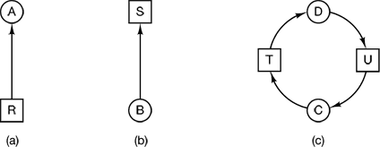
Deadlock…
Deadlock Modeling
  Deadlock can be modeled using directed graphs.
  The graphs have two kinds of nodes: processes, shown as circles, and resources, shown as squares.
  An arc from a resource node (square) to a process node (circle) means that the resource has previously been requested by, granted to, and is currently held by that process.
  In the figure above, a depicts resource R is currently assigned to process A
  An arc from a process to a resource means that the process is currently blocked waiting for that resource. In the figure above, B depicts process B is waiting for resource S.
  Figure C depicts a deadlock

Slide 65
Deadlock…
Dealing with Deadlocks
  In general, four strategies are used for dealing with deadlocks. These are:
    Just ignoring the problem altogether ( the Ostrich Algorithm)
    Detection and recovery (let deadlocks occur, detect them, and take action.)
      Some of the techniques to recover from deadlock are
        Recovery through Preemption - temporarily
        Recovery through Rollback
        Recovery through Killing Processes
    Dynamic avoidance by careful resource allocation.
    Prevention, by structurally negating one of the four conditions necessary to cause a deadlock.

